Slide 1
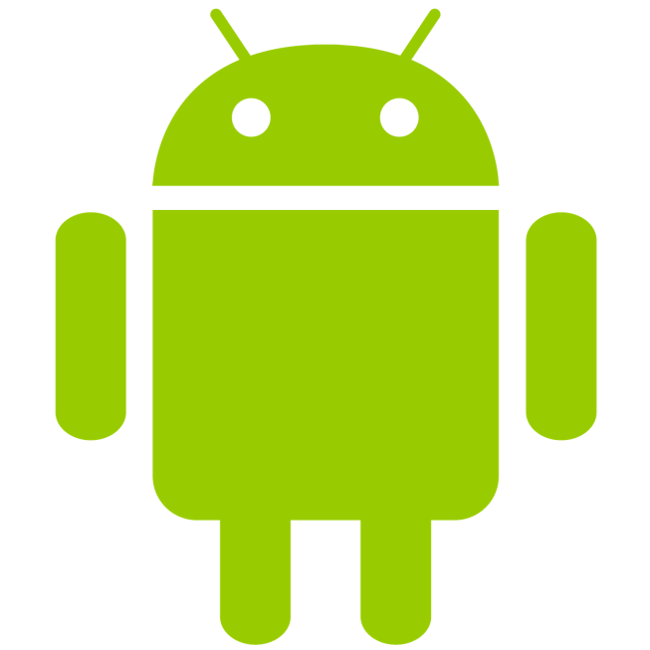
DroidLab – smart experiments
BME TMIT
Dr Rolland Vida, Miklós Máté, Balázs Lajtha

Slide 2
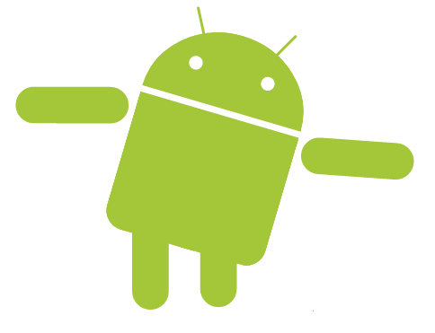
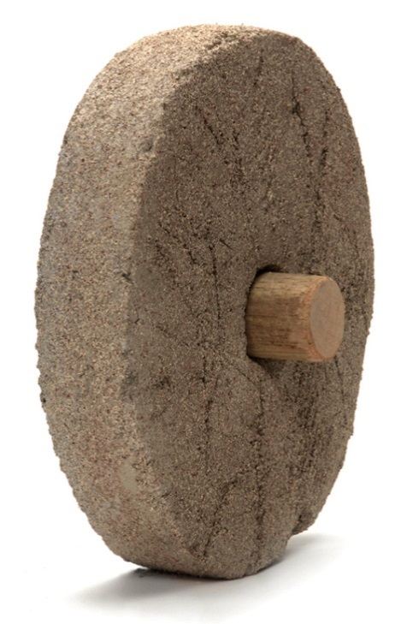
DroidLab – smart experiments
Now on wheels!
BME TMIT
Dr Rolland Vida, Miklós Máté, Balázs Lajtha

Slide 3
Problem
Mobile testbeds are expensive to maintain: fast development of mobile technologies makes older testbeds obsolete, devices are costly
Simulating user behavior, movement, environment in contained experiments is impossible

Slide 4
Solution: crowd sensing apps
Embed measurements in user applications
Publish app in stores, ask/pay people to download it

Slide 5
Problem
Creating an app requires skill and is time consuming
Collecting data requires infrastructure
Building a user base for a single experiment is costly

Slide 6
Solution: DroidLab
A framework for mobile experiments
Modular platform to match participants privacy concerns
Experiments can be deployed to existing user base

Slide 7
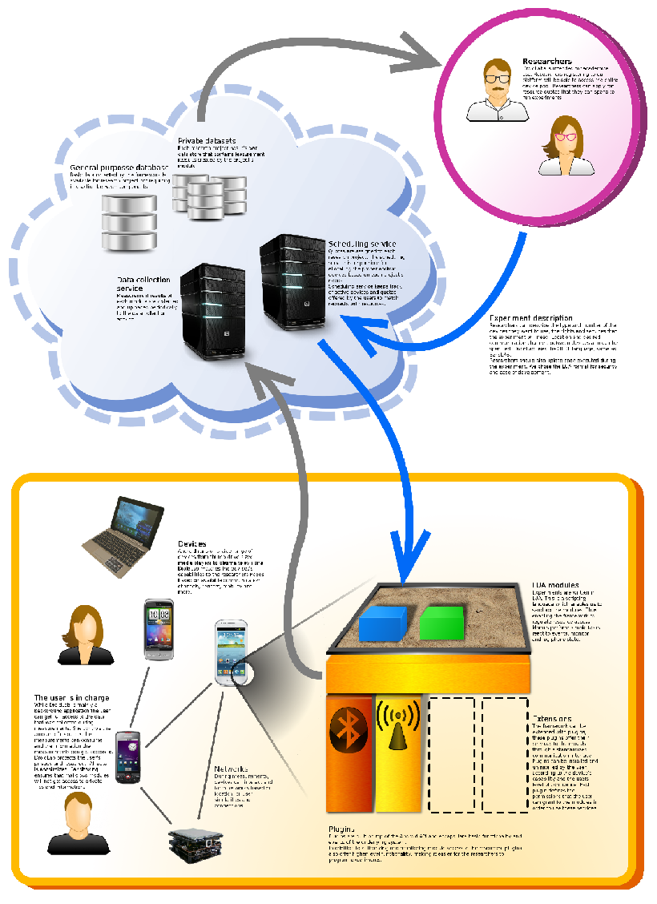

DroidLab in a nutshell

Slide 8
How it works
An Android application that acts as a container for experiments
Data sources providing device dependent functionality to experiments
Checked experiment code can be deployed to device pool
Controlled resource consumption
Cloud based result storage

Slide 9
Benefits
Shared user base
No opting in required for the user for each experiment
Instant deployment of experiments
Highly scalable
Can target users based on hardware, location or profile
No boiler-plate code:
required by the platform (Activities, Services, Permissions…)
required by the user (resource management, anonymity) or the use case (log collection, storage, uploading) is incorporated in the framework, researchers need only to write the business logic

Slide 10
Use cases
Measurement cases:
User movement patterns (micro movement through sensors or macro movement through location)
Cellular coverage, WiFi coverage, QoS probing
User behavior: number of installed apps, app usage frequencies, phone book size, phone call patterns, charging habits…

Slide 11
Use cases
Distributed network cases:
DTN messaging through close proximity protocols (NFC, Bluetooth)
Routing on fast changing mobile networks
Epidemic progression
Distributed caching and content delivery

Slide 12
DroidLab + Vehicle ICT
DroidLab brings
Dynamic client side data processing
Dynamic data structures
Integration of non-vehicular data

Slide 13
Use cases
Vehicular cases:
Vehicle ICT data source adds additional context to measurements
Bootstrapping vehicular crowdsensing applications
Detecting vehicle usage patterns

Slide 14
Questions + Demo

Slide 15
Thank you for your attention!

